Slide 1
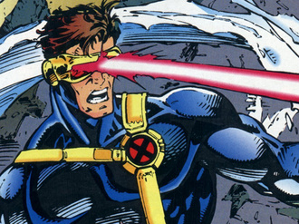
Laser Cat
Presented by:
Almeda Glenn Brandon Tan Troy Toh Lim Wei Heng
Credits are given to the pictures in this presentation

Slide 2
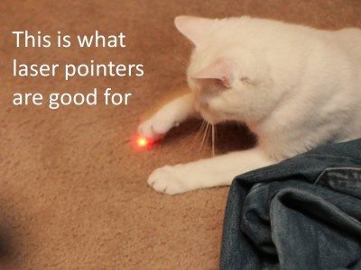

Slide 3
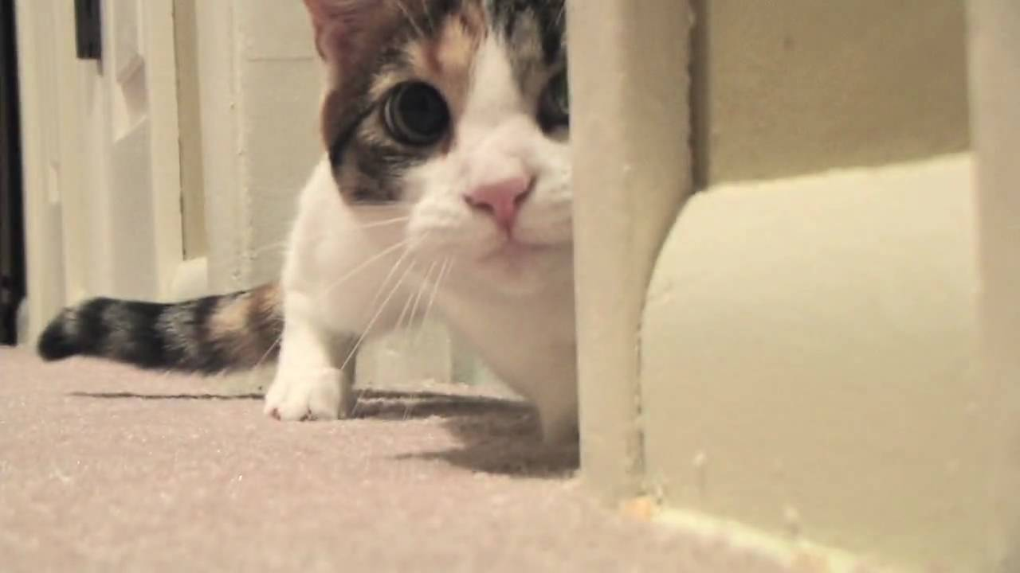
Overview
Gameplay Samples
Screenshots (Before & After)
Reviews(?)
Risks/Concerns
Random Inspirations
Q&A

Slide 4
Gameplay Samples

Slide 5
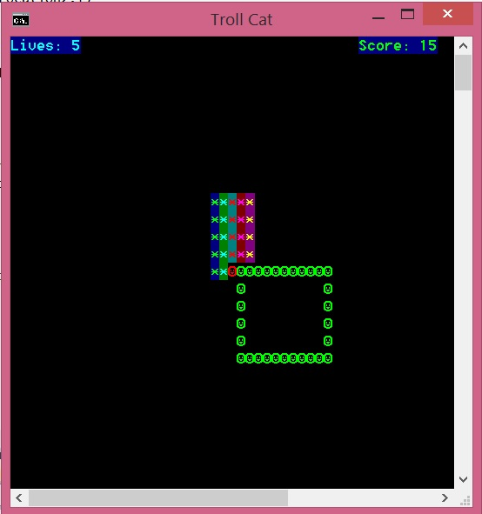
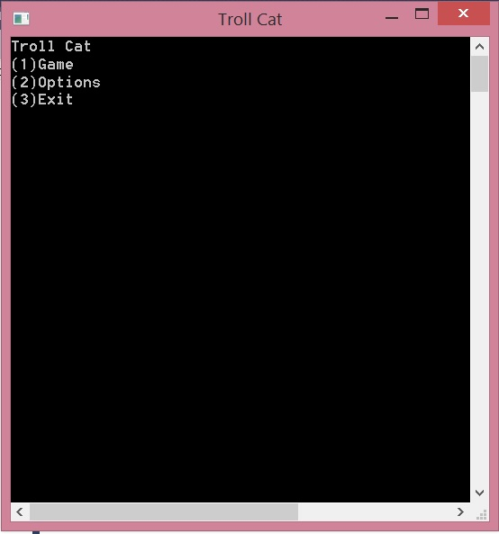
Screenshots (Before)
Initial Menu →
← Initial Gameplay

Slide 6
Screenshots (After)
//final product of the game

Slide 7

Risks/Problems/Concerns
//to brainstorm some potential issues we are aware of….

Slide 8
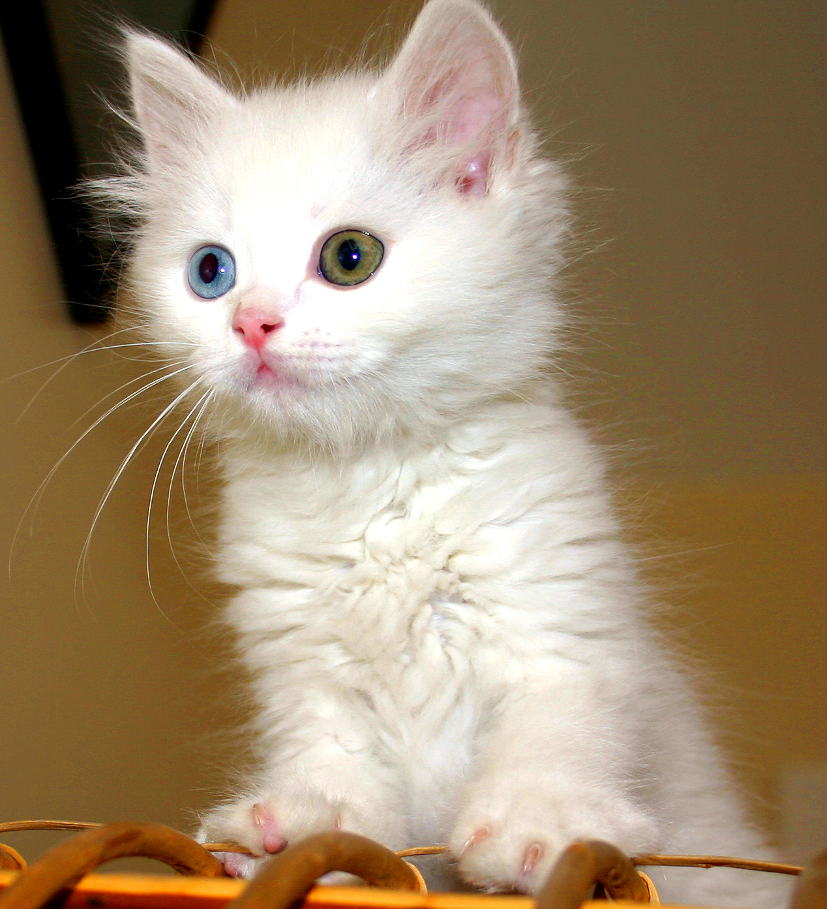
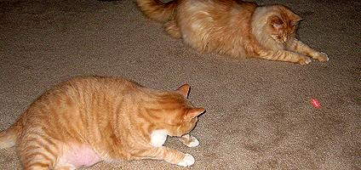
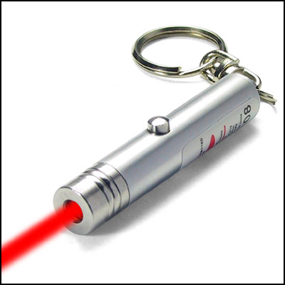
Inspirations

Slide 9
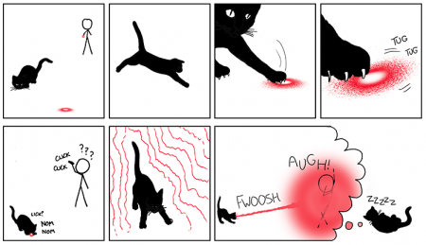
Inspirations

Slide 10
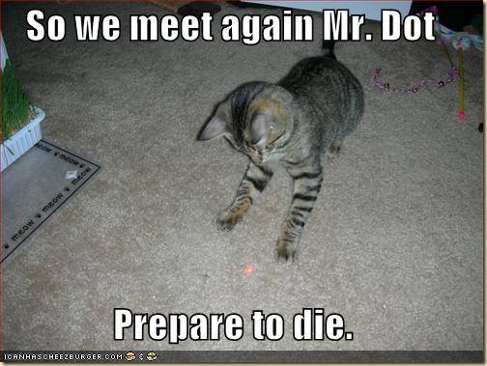

Slide 11
Thank You!!

